Slide 1
Running k3s, Lightweight Kubernetes, in Production for the Edge and Beyond
Darren Shepherd

Slide 2
Overview
Quick overview of k3s
And some pointers
Use Cases
Edge
App Cluster
Pipeline (CI/CD)

Slide 3



Darren Shepherd – Speaker
CTO and Co-Founder at Rancher Labs
@ibuildthecloud on
Creator of k3s (and other Rancher projects)
Been doing cloud orchestration for 10+ years.

Slide 4
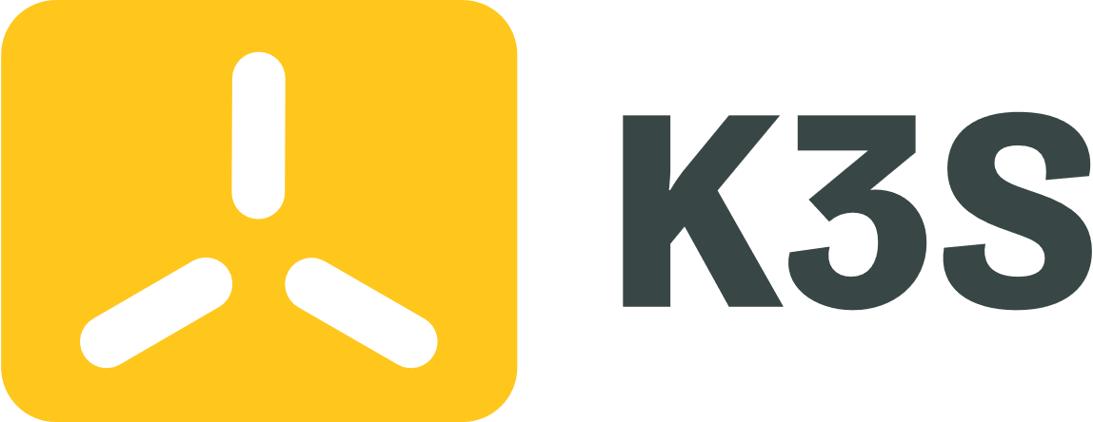


K3s is becoming a CNCF Sandbox Project

Slide 5
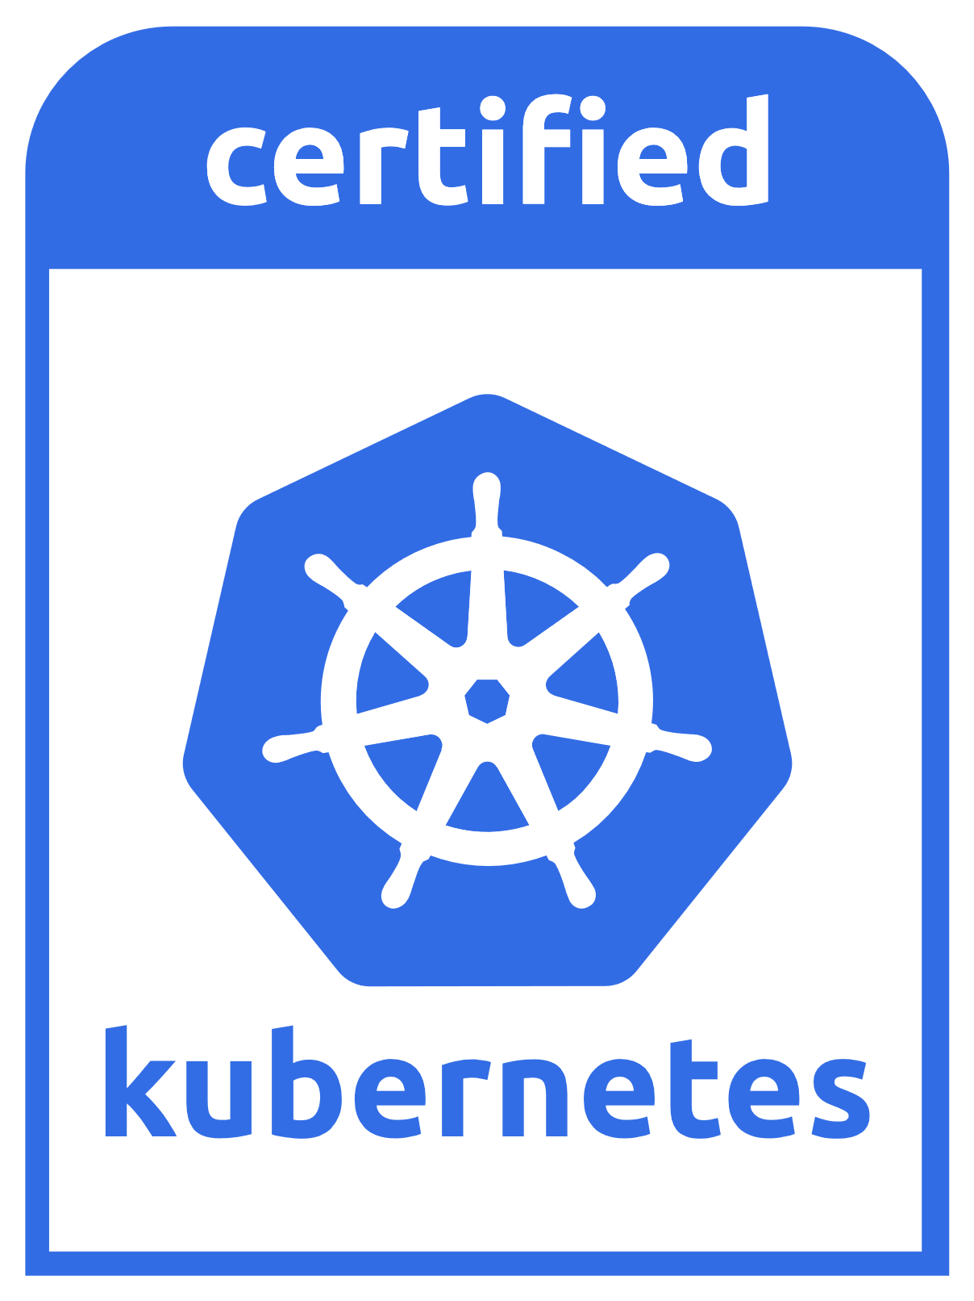

What is k3s
Lightweight Kubernetes
Single Binary Size (~50mb)
Memory Size (~300mb)
Perfect for the Edge
Used just about everywhere
Low Cognitive Load ( )
Designed for production
Fully CNCF Certified
Secure by default
Best practice defaults
Kubernetes Distribution
Opinionated
Complete
Strong focus on simplicity

Slide 6
Random Points - Easy to Install
Very easy to install and run. Like really, really, really easy
Single binary, just copy it or whatever you want
“k3s server” <- That’s a production ready single node cluster.

Slide 7
Cont. – Easy to Include Apps
/var/lib/rancher/k3s/server/manifests
Any k8s manifest (yaml) here gets loaded on start
/var/lib/rancher/k3s/agent/images
Any OCI or Docker image tarball will be loaded on start
HelmChart is a built in Kind in k3s
apiVersion: helm.cattle.io/v1
kind: HelmChart
metadata:
name: traefik
namespace: kube-system
spec:
chart: stable/traefik
valuesContent: |-
rbac:
enabled: true

Slide 8
Cont. – Minimal Ops
k3s supports sqlite, MySQL, Postgres and SQL Server, Oracle coming soon
Just get a managed DB.
Enabled by embedding Kine https://github.com/rancher/kine
etcd
External: That’s your traditional setup (this is not fun)
Embedded: Included in k3s binary and managed by k3s (like Swarm)

Slide 9
Edge
What do we mean by edge?
Fairly powerful small devices (minimum 1gb memory)
Retail, Branch, Factory, Planes, Trains, and Automobiles
Wind turbines, Set Top Box, Drive Thru Menu, Your refrigerator, Probably your coffee machine, etc.
Why?
Application at the edge are getting more complicated
k8s brings better tools and consistency with cloud/datacenter.

Slide 10
Edge
Mostly 1, 2 or 3 node clusters.
1 Node – Embedded sqlite
2 Nodes – External DB (MySQL, Postgres, others coming soon)
3 Nodes – Embedded etcd (experimental on k3s master, GA this year)
Lots and Lots of clusters,1000’s,10000’s

Slide 11
Edge – Keep it simple
Don’t go overboard using k8s features. Less is more
Leverage host paths for persistence
Ideally treat k8s as a stateless thing
Explicit node scheduling, or always DaemonSet
You know exactly the number of nodes you have, plan for it

Slide 12
Edge – Management
Start with what you have
Managing k3s is mostly managing
k3s binary on system
k3s config (a config file)
Apps to deploy (manifest folder)
It could be as simple as rsync
GitOps maps very well to this model
Most gitops solutions don’t scale well for edge though.
Challenges/Gaps with edge
Most k8s tools won’t scale for edge
Don’t deal with bad network connections
You still have a hardware, OS management problem

Slide 13
App Clusters
A cluster dedicated to a single application
Can be very small (1-3 nodes) or very large (1000-5000)
Runs well in the cloud (k3s supports out of tree cloud providers) or anywhere
Don’t dedicate resources for control plane
Use a managed database (like RDS) for the datastore
DB requirements are very minimal, use a cheap instance.
Extremely simple to automate

Slide 14
Pipeline
Use case is to run quick tests for your application in k8s
Ephemeral clusters as part of a pipeline
As part of the pipeline run k3s locally
Create manifests an put in ${k3s}/manifest
Docker build images and run “docker save … > ${k3s}/images/app.tar”
Wait for app to start, run tests.
k3s can run in rootless mode too (experimental)
Community is working on this flow for Windows too.

